Slide 1
INDUSTRIAL PRODUCTION OF ERYTHROMYCIN

Slide 2
INTRODUCTION
Erythromycin is used to treat certain infections caused by bacteria, such as:
infections of the respiratory tract, including bronchitis, pneumonia, Legionnaires' disease (a type of lung infection), and pertussis (whooping cough; a serious infection that can cause severe coughing);
diphtheria (a serious infection in the throat);
sexually transmitted diseases (STD), including syphilis; and ear, intestine, gynecological, urinary tract, and skin infections.

Slide 3
Conti…
It also is used to prevent recurrent rheumatic fever.
Erythromycin is in a class of medications called macrolide antibiotics.
It works by stopping the growth of bacteria.
Antibiotics such as erythromycin will not work for colds, flu, or other viral infections.
Taking antibiotics when they are not needed increases your risk of getting an infection later that resists antibiotic treatment.

Slide 4
INOCULUM
The sporulation of Streptomyces erythraeus is done on tryptone agar slant.
The cells are harvested from agar plates and the suspension is taken in sterile water.
Stored at 4°c.
pH
7.0-7.2.

Slide 5
MEDIUM
Sucrose(5%)
Corn steep liquor(0.5%)
Soyabean oil meal(1.5%)
Yeast(1.0%)
NaCl(0.5%)
CaCo3 precipitate(0.3%)

Slide 6
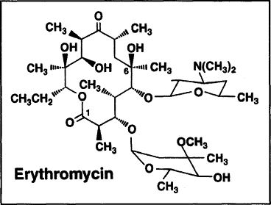
FERMENTATION
Stirred tank fermenter .
Production of erythromycin occurs when froth reaches stationary phase.
Addition of n-propanol as precursor increase erythromycin .

Slide 7
ISOLATION AND EXTRACTION
ISOLATION
Mycelium is separated from the broth by centrifugation or drum filtration.
Acidic condition favors the separation of mycelium from the broth
EXTRACTION
Antibiotic is extracted using water immiscible organic solvent
pH is adjusted with Acidic Acid or Citric Acid
Purification and concentration is carried out with ion exchange resin

Slide 8
PRODUCTION OF TETRACYCLINE

Slide 9
PRODUCTION OF TETRACYCLINE
Tetracyclines are broad-spectrum antibiotics mainly active against Gram-positive and Gram-negative bacteria, rickettsia, and some large viruses.
These antibiotics are produced mainly by Streptomyces aureofaciens and Streptomyces rimosus.
Aureomycin (chlortetracycline) is discovered by Duggar (1948) which was produced by fermentation of Streptomyces aureofaciens.
Oxytetracycline was produced by fermentation of Streptomyces rimosus.

Slide 10
Conti…
Streptomyces aureofaciens ATCC 13908-13911 and NCI B-9114 are used for the industrial production of tetracycline.
The stock cultures are maintained for longer periods in the form of lyophilized spores or at liquid nitrogen temperature as spore stock.
Tetracycline antibiotic yield can be improved by mutagens like UV light, X-rays, γ-radiation, ethylene amine, and nitrogen mustards, alone or in combinations.

Slide 11
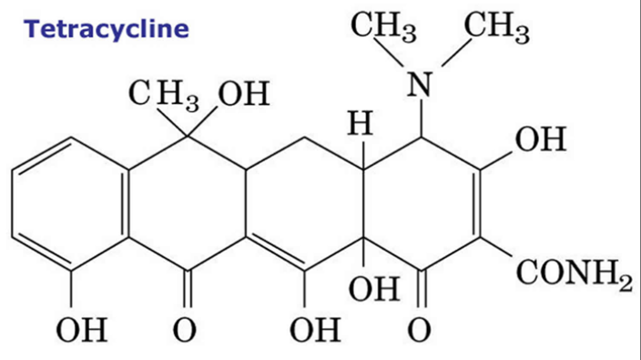
STRUCTURES OF TETRACYCLINES

Slide 12
INOCULUM DEVELOPMENT:
The medium used for inoculum development contains:
carbohydrates (sucrose and maltose)- 2.5%
corn-steep liquor 1.7%
calcium carbonate 1%, (NH4)2SO4 – 0.2%, and
other inorganic salts and minerals.

Slide 13
Conti…
The different steps in the inoculum development of tetracycline production are shown in Fig. 5.13.
The culture is monitored for
Temperature
pH, residual sugar
carbon dioxide
biomass, etc.
Optimum yield is obtained from a medium containing inoculum for 24 hours.

Slide 14
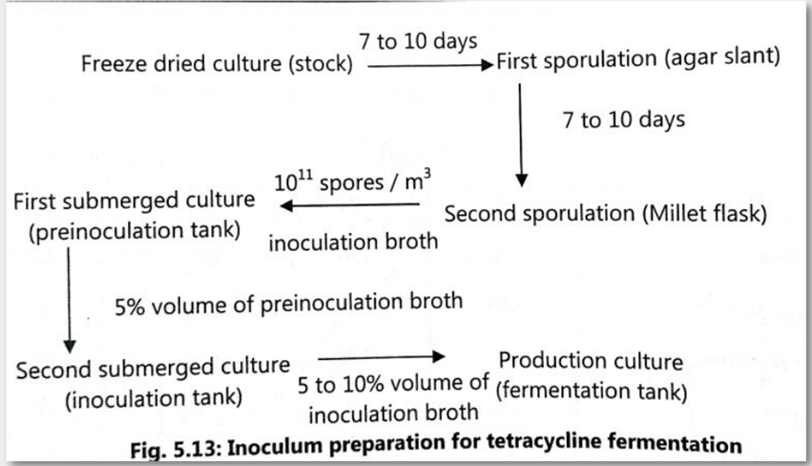

Slide 15
FERMENTATION
Tetracyclines are obtained by the submerged culture technique.
A typical medium for the production of tetracycline by fermentation contains
carbon sources (e.g. sucrose, dextrose. corn starch, vegetable oils)
nitrogen sources (e.g. corn-steep liquor, soybean meal, peanut meal), and
inorganic salts ( ZnSO4, NaCl, etc).
Lactose and saccharose are not used by Streptomyces species.
Animal and vegetable oils are used as antifoaming agents as well as carbon sources.
Calcium carbonate helps in maintaining pH and also binds with antibiotics. Hence, it prevents product accumulation and inhibition of product formation.

Slide 16
Conti…
The fermentation is conducted at 28 to 30°C, pH 6 to 6.5, and aeration level of 0.5 to 0.8 volume of air per volume of liquid per minute.
The fermentation process may be batch or semi-continuous type.
The yield of antibiotics depends upon pH, age of the inoculum, and composition of the medium.
Aeration of the culture is also very important for the biosynthesis of antibiotic.

Slide 17
PRODUCT RECOVERY
Tetracycline is obtained from the filtrate of the acidic medium by adsorption on diatomaceous earth (Diatomaceous earth diatomite or kieselgur/kieselguhr is a naturally occurring, soft, siliceous sedimentary rock) or activated charcoal.
It is precipitated in the form of salts with metals of alkaline earth.
Extraction is carried from the broth with 1-butanol or in addition to a carrier i.e. quaternary ammonium compounds.

Slide 18
Conti…
Tetracycline forms complex salt with divalent Ca²⁺and Mg²⁺.
It is purified by crystallization as salts or bases from boiling solvents like lower alcohols ketones etc.

